Slide 1
Muscle-Based GYM Application
Moldovand Horia-Andrei
Faculty of Automation and Computer Science

Slide 2
General Presentation
Roughly speaking the Muscle-Based GYM Application is a web app and as its name suggests, it contains different lists of exercises, grouped on muscle categories. The exercises are organized in such a manner so that the user can find the desired exercise/exercises as fast as possible. So we can say that simplicity and effectiveness are two of the main attributes this app tries to combine.

Slide 3
IT Technology
In order to achieve the desired functionality of the application, SpringToolSuite IDE and MySql Database will be used. One of the most important tasks will be to carefully combine the java programming language with html and css, in order for the app to work and look in the way we want.

Slide 4
Targeted Audience
The Application was made in such a way so that literally anyone who is medically allowed to do physical activities can make use of it. Each exercise comes with its own difficulty level so the user will be able to choose among all exercises based on his own current physical status. That’s possible because exercises starting from beginner up to advanced level will be provided.

Slide 5


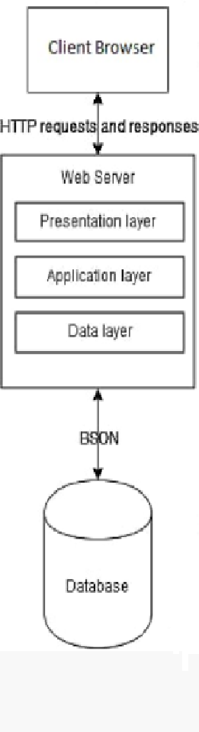

System Architecture
The architecture of the application will be designed in such a way that allows us to take care of the user requests by understanding what kind of information is requested and carefully search it through the database, in order to be able to send back to the user the desired output.

Slide 6
Functionalities
The main purpose of this app is to free the user of the task of individually searching among different sources exercises for his workout. Why bother to spend time by doing such things when you have all you want under an easy accessible compact form.
Besides that, not only you can find predefined lists of different interesting workouts, consisting of exercises inspired from the workout routine of bodybuilders which had an impact on the fitness industry, but you can also create your own exercise lists.

Slide 7
What’s new?
In addition to the things already presented, all the exercises come with an explanation which describes things like how the exercises should be correctfully performed, with what other kind of exercises may be combined, the suggested amount of sets, reps and time of rest or even minor execution variations of the chosen exercise, which are meant to have a slightly different impact on the muscle.

Slide 8
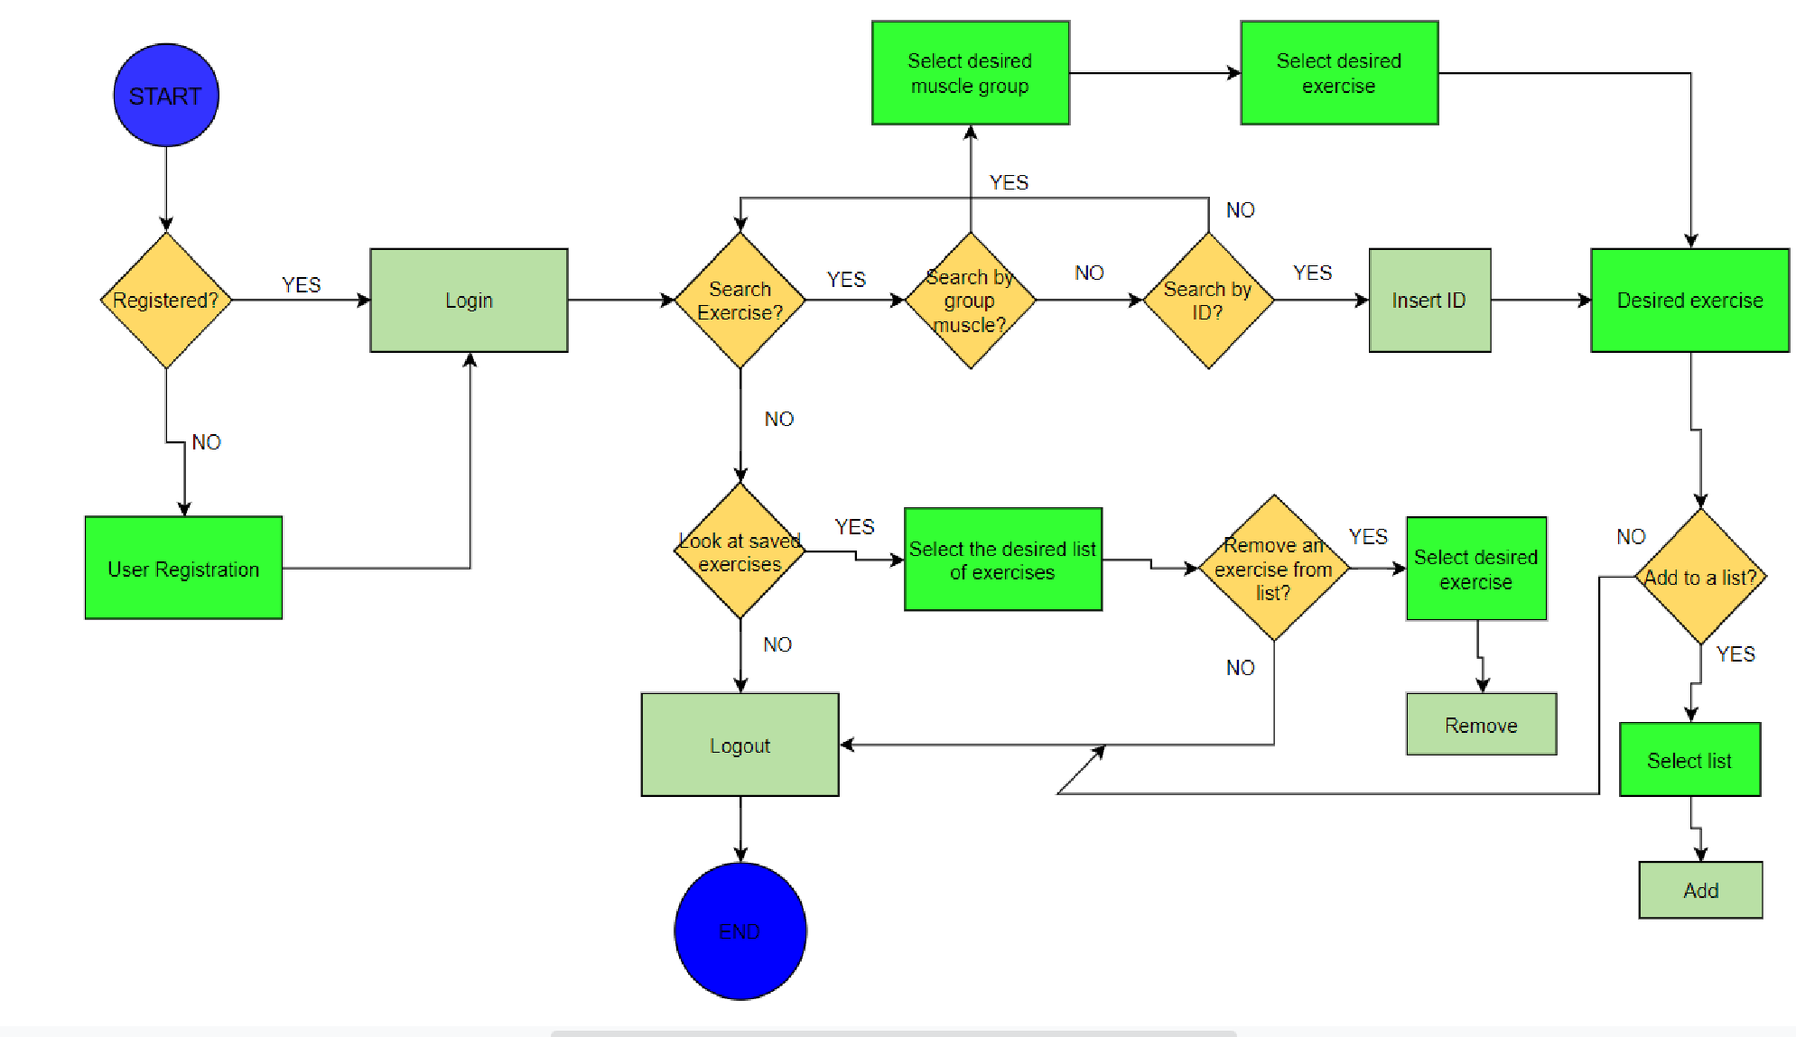
Use Case Diagram

Slide 9
Use Case Explaination
A valid user of the application is one which has created an account with an already unused name and a password. After creating an account different functionalities are provided. If the user is in the search of some exercises he has the choice of selecting a group muscle and looking at the provided exercises or searching the exercise by its ID. A table with specific exercise name and their corresponding ID will be also provided.
Beside that, the user can also create or update his custom created exercise lists by adding or removing an exercise.

Slide 10
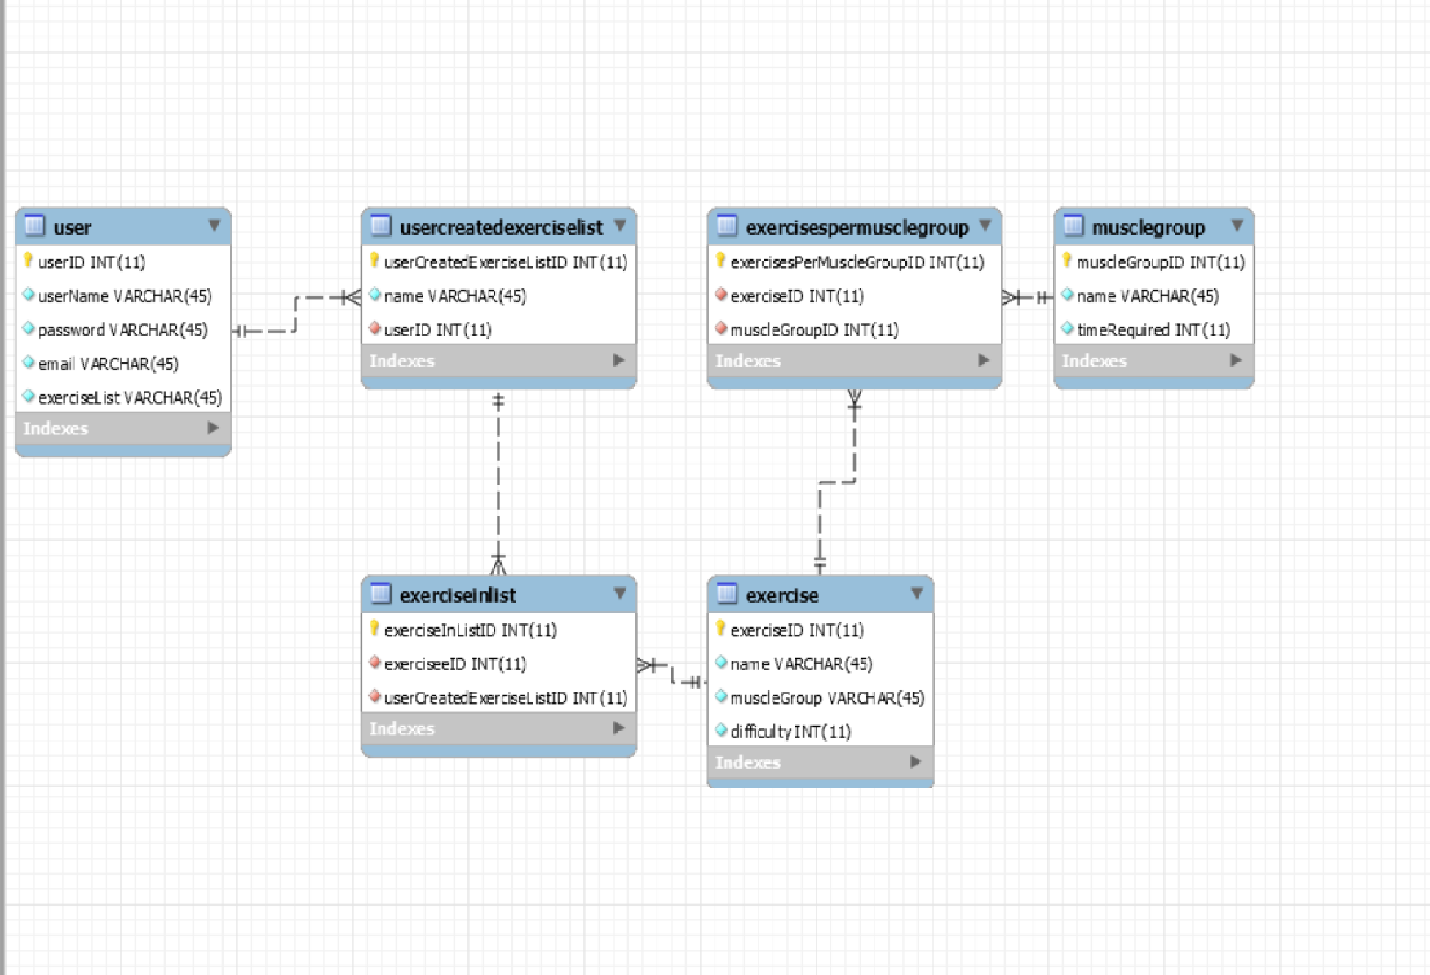
About the database
The scope of the database is to hold the provided exercises and the users with their custom created exercise lists in an somehow organised manner. The exercise table with the colouns presented in the shown picture will be provided to the user as well, in order for him to easily search the id of the desired exercise. After found, he can easily use the search by Id function in order to find more detailed information about it. So basically the database is used in order to keep all the info organised and clean and most importantly making it easy to be found.

Slide 11
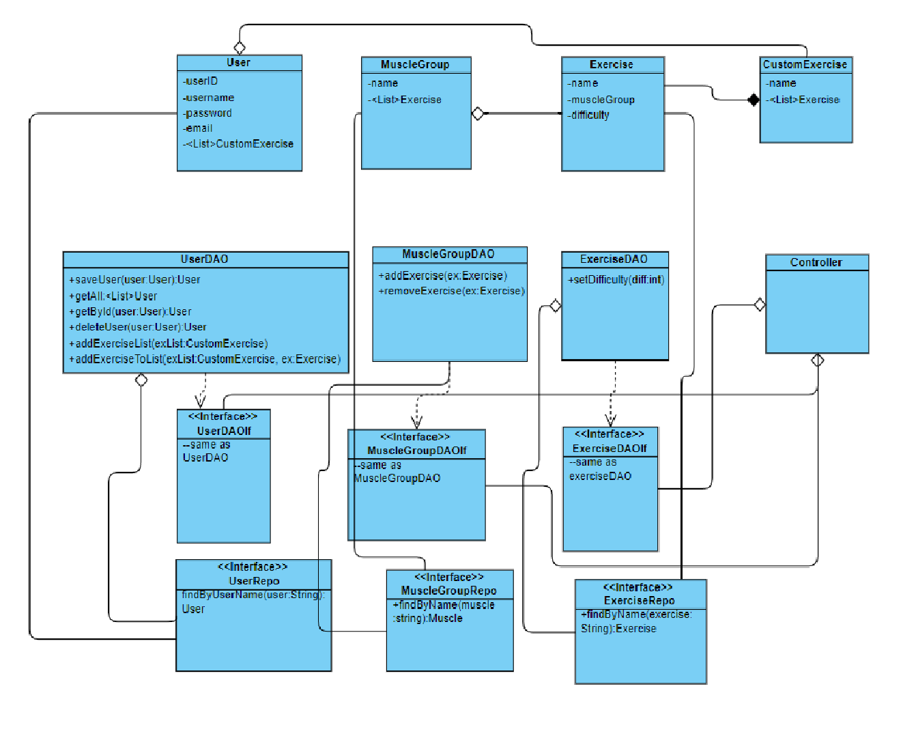
Class Diagram

Slide 12
Class Diagram Expanation
The class diagram was designed in such a manner in order for the communication between our application and the My SQL database to work as flowless as desired. So basically an individual class was created for each table in the database. The communication with their containing data is done through the Repositories. The Data Access Object pattern was used in order to make able the isolation of the application layer from the persistance layer(the relational database). So basically all the complex functions and operations are hidden in order for the both layers to be be able to perform individually.

Slide 13
Accesibility
The app will be accessible from any kind of internet browser and in the future it might be also converted to an android app so the users can to download it from their phones too.

Slide 14
Will it help me?
After all, this is just an application wich is only providing information and suggestions. In order for something to happen the user will have to do the hard work himself. The app supplies all the knowledge the user needs, but it depends on him if he implements the knowledge we provide or not.

Slide 15
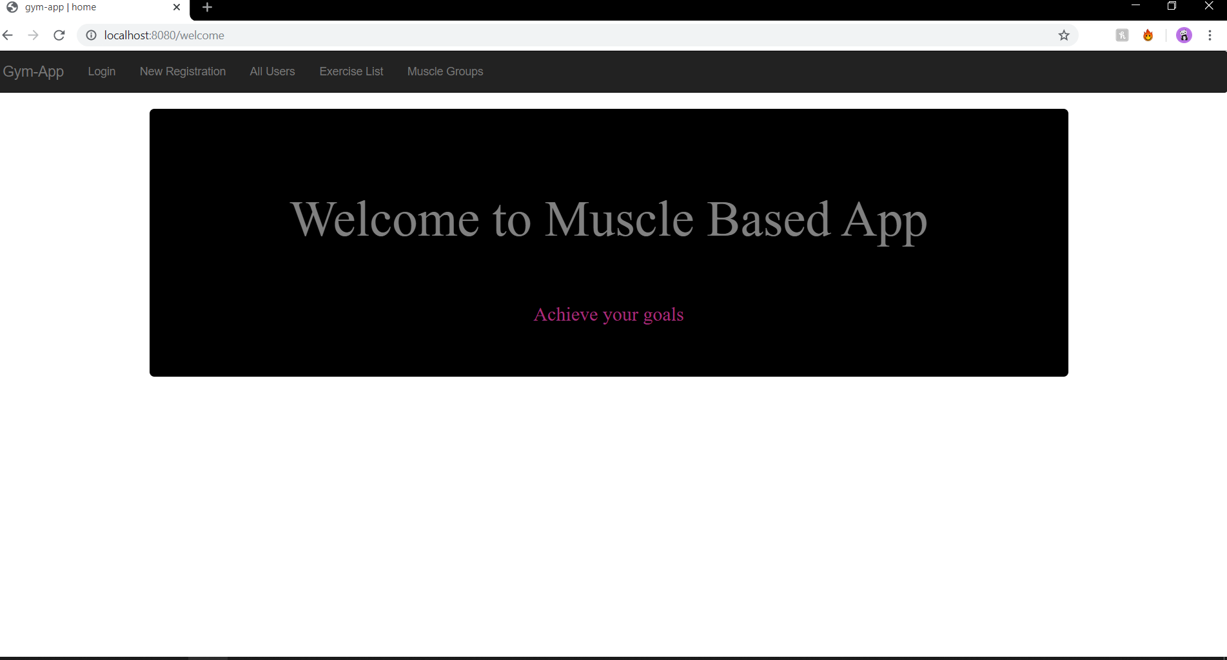

Slide 16
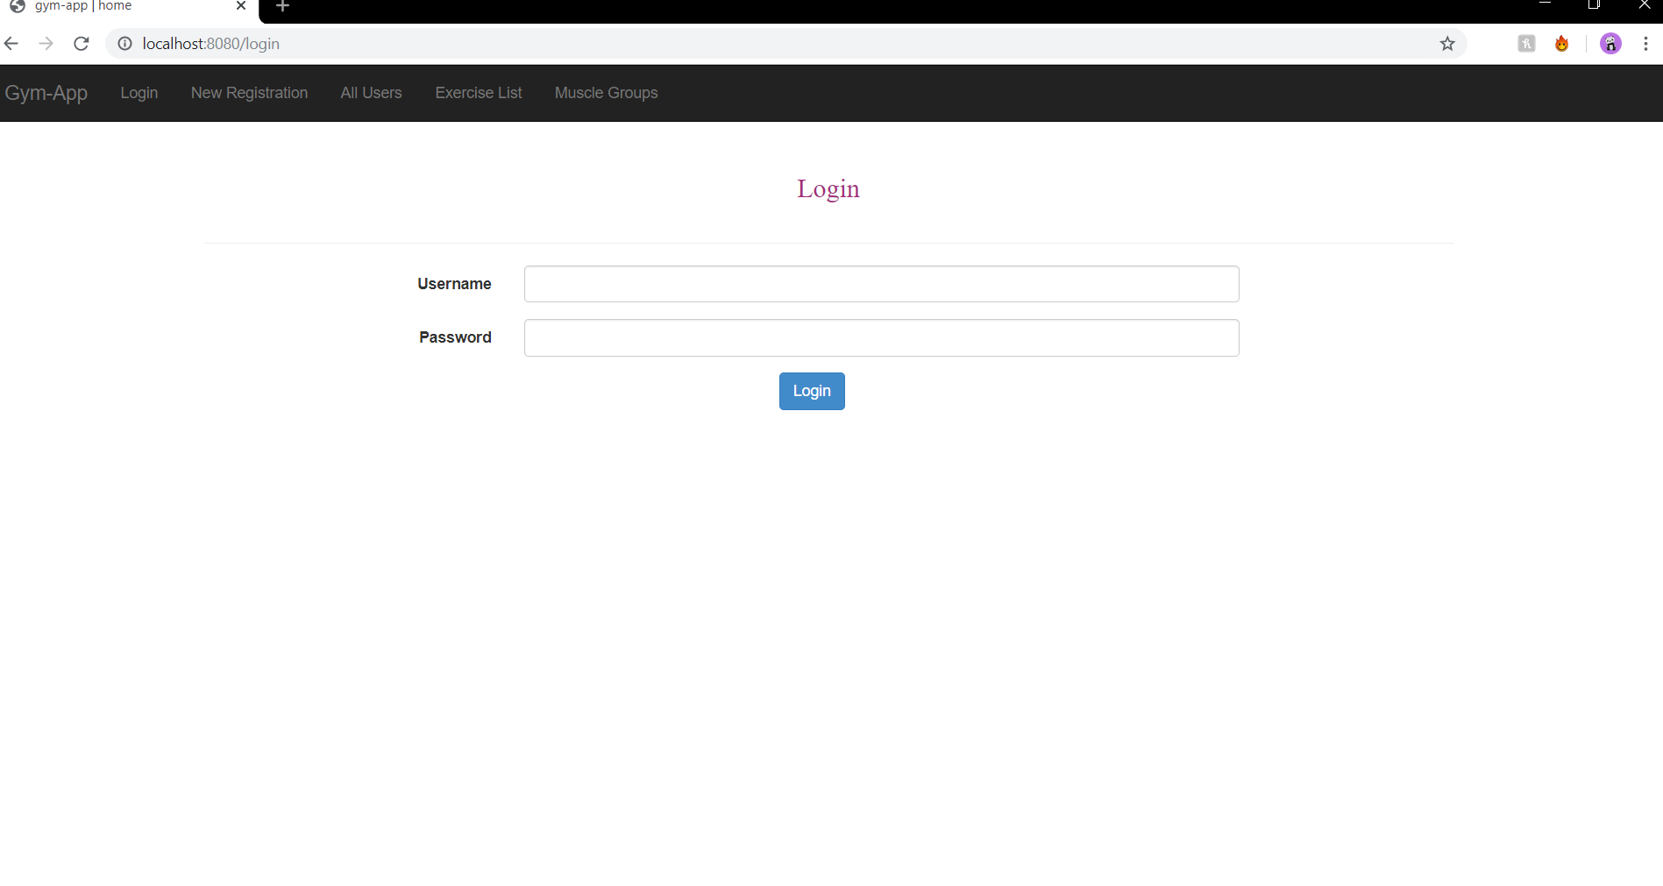

Slide 17
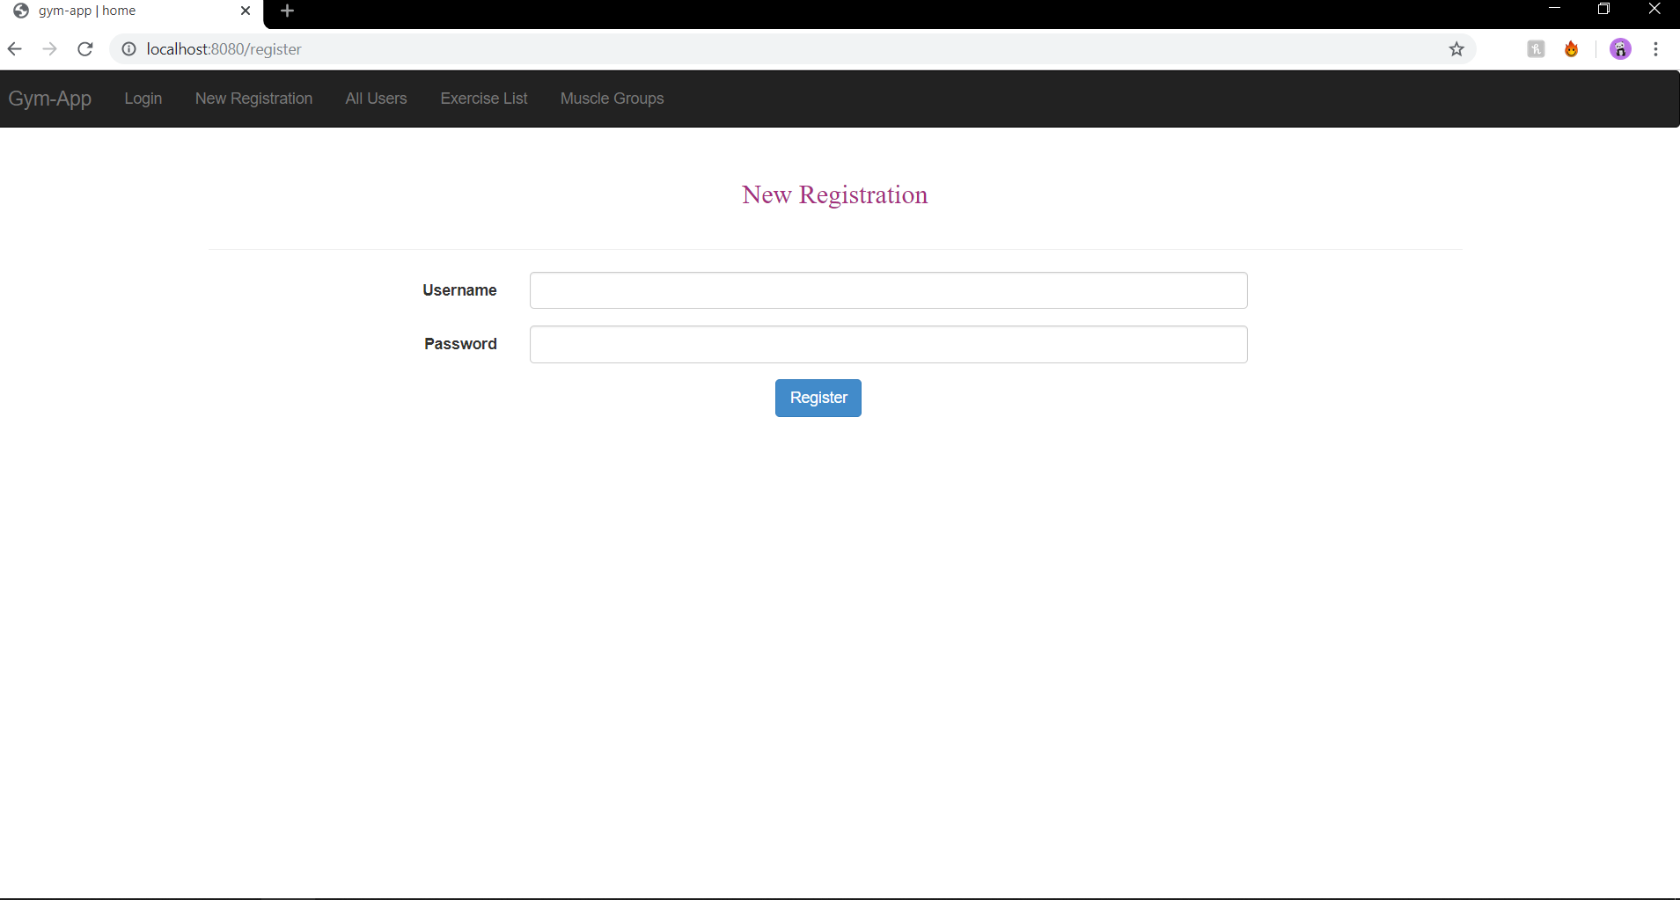

Slide 18
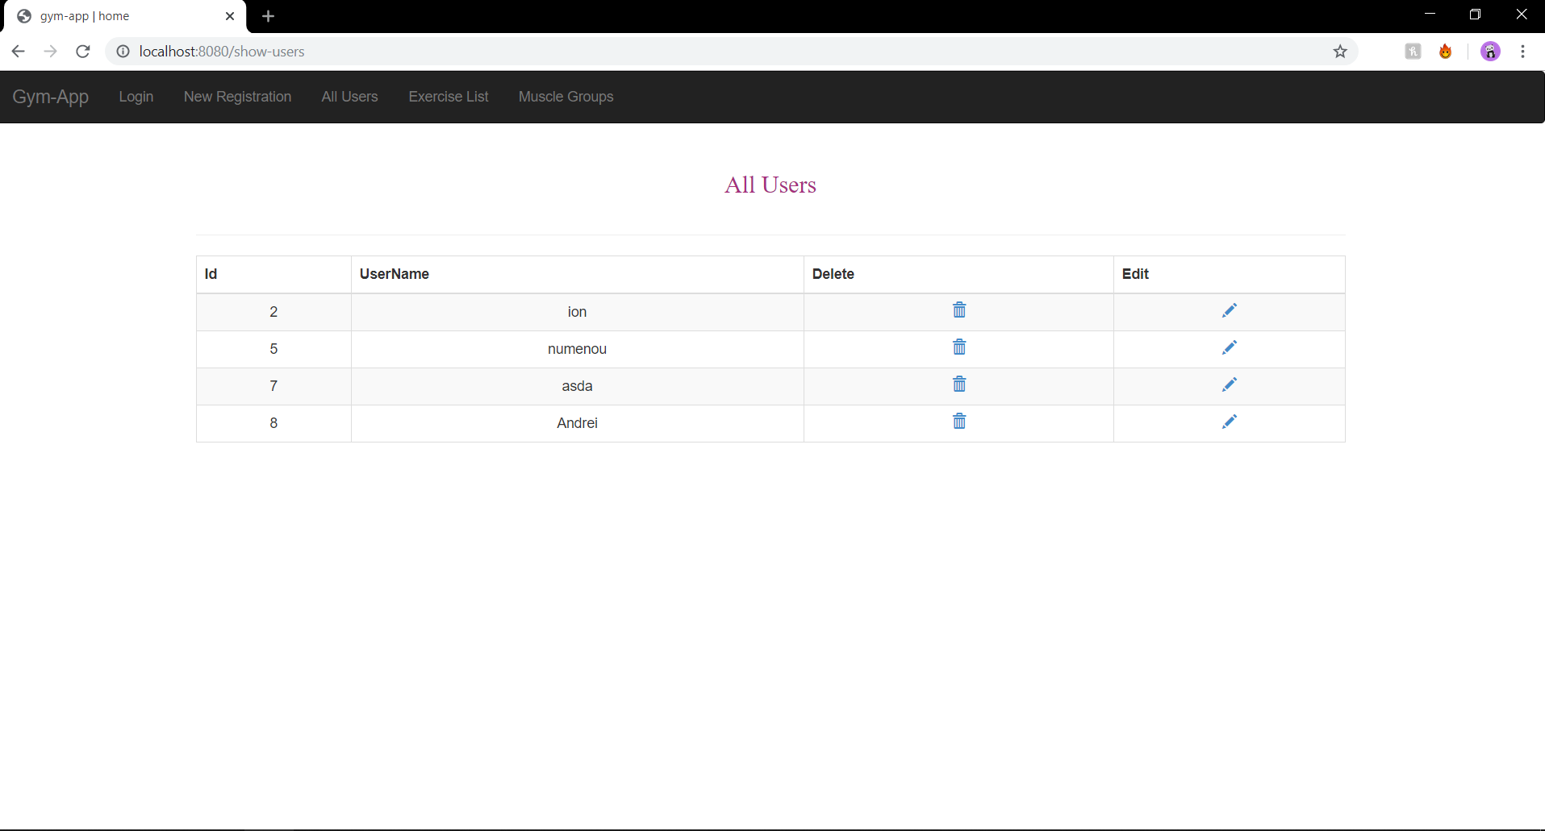

Slide 19
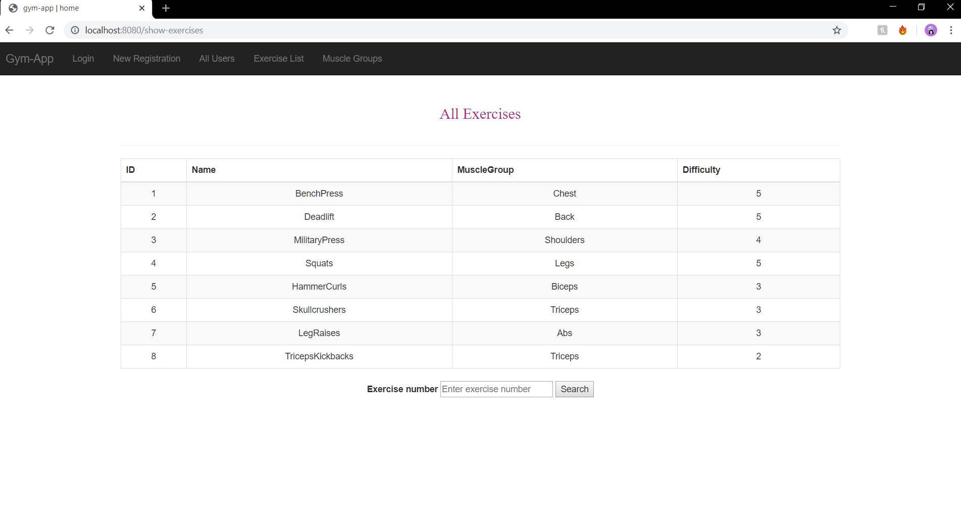

Slide 20
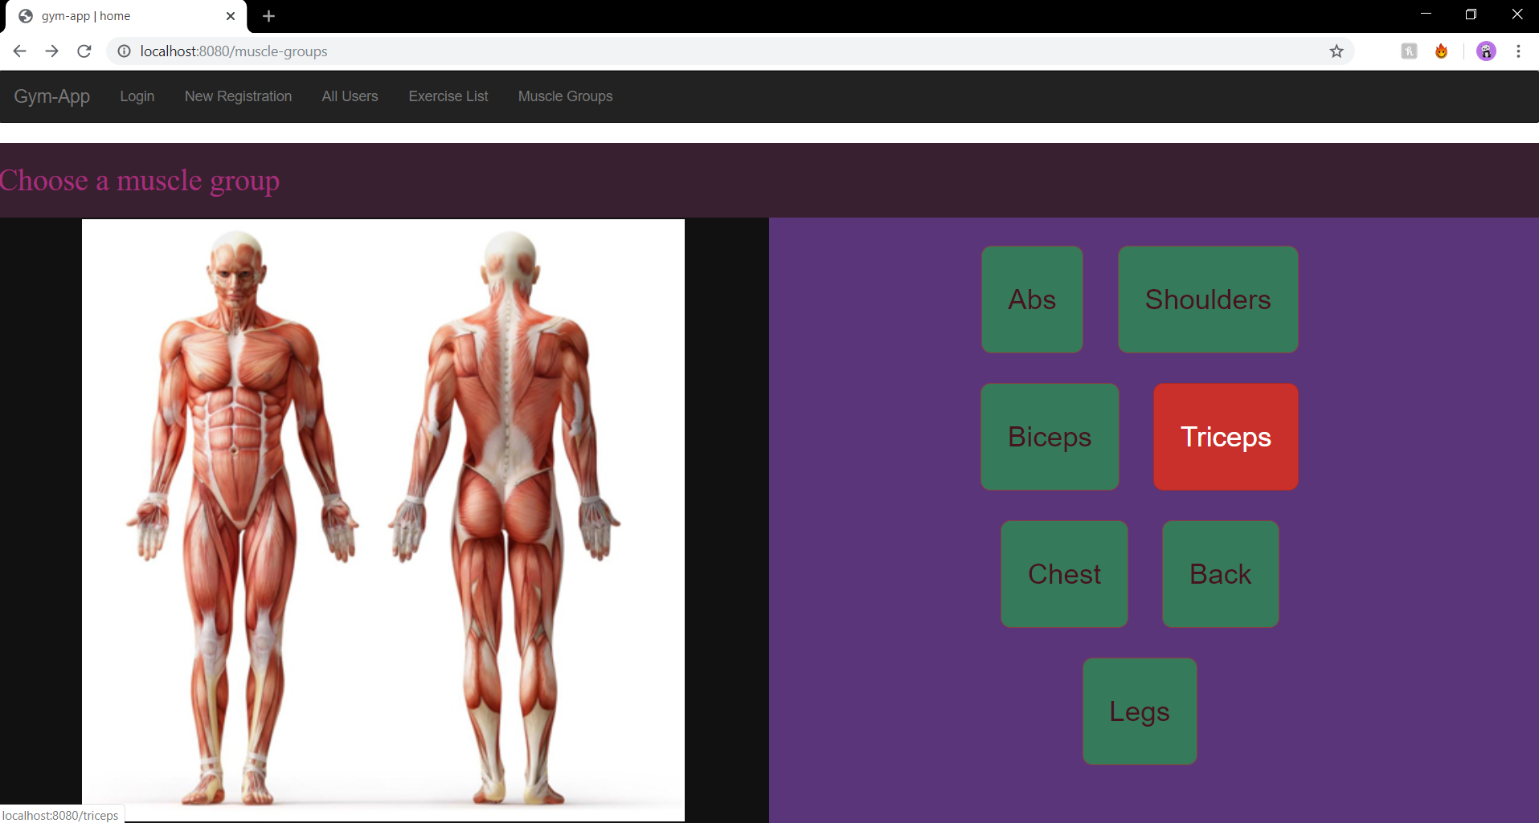

Slide 21
